Slide 1

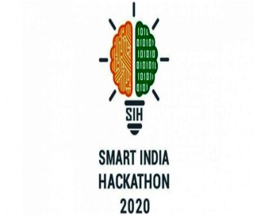
Smart India Hackathon
Ministry Category: Central Ministry
Problem Statement: Air/Water Turbidity
Estimation using mobile App
Problem Code: NM370
Team Name: Generation Teens
Team Leader Name: Kartik Jain
College Code: 1-3512866904

Slide 2

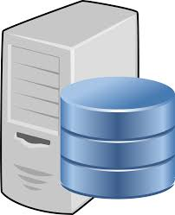
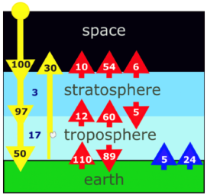


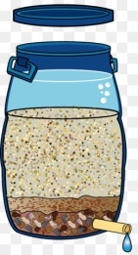

Prototype Model
Calculate air optimal thickness though langley plot
Calculate angstrom exponent
Apply image processing and deep learning on server
Sun
Calculate Zenith Angle by time and lat & Long
Get water and Air turbidity
Take different images of sun form same location and adjust the phone to elevation angle.
User will select which method to apply between deep learning and remote sensing reflectance
Calculate the angle of mobile with sun using Gyroscope
Take image of grey card
Request for
Location(Long & Lat)
Take image of Turbid Water
Google Location API
Get the Location
Take image of sun
Mobile Application
Turbid Water

Slide 3
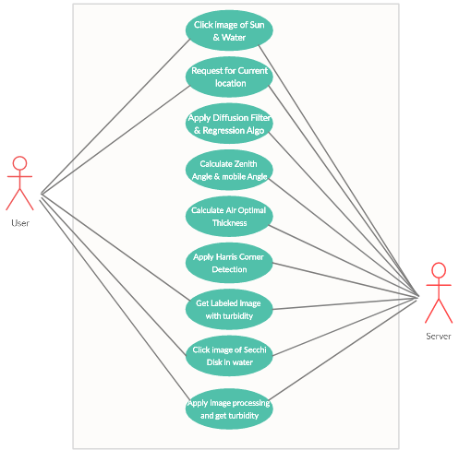
Use Case Diagram
Installation
Uption and
User: User Share his current location, click image of sun & water and get a labeled image with turbidity as output.
Register
Look
angles
Login
Server: Server will apply Image processing, calculate zenith angle , mobile angle and apply Regression to get RGB model. Finally it will return a labeled image to user as with turbidity written as output.
Server will apply deep learning or remote sensing reflactance to get water turbidity
Offset pointing
Antenna
Enter
problems
Transpo
nders
Logout

Slide 4

Solution Approach
We will provide a mobile application to determine turbidity in air & water.
Air Turbidity:
Fetching user’s current location and calculating zenith angle according to current location and time.
User will adjust its smartphone to elevation angle showing on app screen.
User will click 5-10 image of sun from elevation angle and same location after every 30 minutes.
Images and their respective angle will go and server for image processing.
Air mass will be calculated of each image from their respective zenith angle.
Apply image processing technique and get intensity of sun.
Then we plot the Langley Plot and get slope of Langley plot which is our aerosol optical depth.
This will return the image with labeling of air turbidity.

Slide 5
Solution Approach
Water Turbidity:
We will provide two approaches for more accurate Turbidity of Water.
First one is that, we have created a Deep Learning model to determine if the turbidity is low, high or medium, in this model we are taking water image as our source and then compare it with our Dataset of images which are segregated into two parts high, medium, and low.
User can also extract the exact value of turbidity by click a button on the app.
Second approach is user will click image of sun, water and grey card of 18 % reflectance for this user has to click images at certain angle termed as Azimuth angle and Zeinth angle. These angle are shown in the App and user only have to take image at that angle only. For this Remote Sensing Reflectance Approach is used and our this approach is giving Turbidity value which is very near to accurate values of turbidity.
The calculated turbidity will be returned to user on mobile screen.

Slide 6
Application Advantages
Our Application is User Friendly and easy to use.
Along with the App we will provide a user guide for easy excess.
More Accurate values.
Data Sharing: The results can be instantaneously shared amongst internal application as well as contacts
Communication: The data transfer is initiated immediately after assuming that the phone is connected to the internet.
Tell the user about the current level of turbidity.

Slide 7





Technology Stack
Python
Dart
Flutter
AWS
Deep learning
Fast API
OpenCV
Dependencies / Show Stopper
For more accurate result smartphone camera should be of good quality.
Grey card will be needed for Water approach.

